Slide 1
Project : AirAware Smart Air Quality Prediction System
Presented by: N.N.Sai Sreya
Group: 1

Slide 2
Problem Statement
Air pollution levels are rising and need continuous monitoring.
Manual monitoring is slow and not easily accessible to the public.
Users need a simple web interface to view real-time/processed air quality status.
This project provides a clean solution using modern web technologies.

Slide 3
Objectives
Collect and store air quality data securely.
Display pollutant levels in a clean, user-friendly dashboard.
Provide visual indicators of air quality (good, moderate, hazardous).
Enable easy expansion for future prediction models.

Slide 4
Technologies Used
React.js: Used to build the user interface with reusable components for dynamic pages.
TypeScript: Adds type safety and makes the frontend code more reliable and structured.
Vite: A fast development server and build tool that speeds up UI loading and development.
HTML & CSS: Used to structure the pages and style the overall layout and design.
Tailwind CSS: Provides utility classes to quickly create responsive and consistent UI styling.
React Hooks: Used to manage component state and lifecycle logic within the UI.

Slide 5
Dashboard Features
Real-time Air Quality Display – Shows the current AQI value clearly on the main dashboard.
Pollutant Breakdown – Displays individual pollutant levels like PM2.5, PM10, CO, etc.
Color-Coded Status Indicator – Uses colors like green/yellow/red to indicate air quality levels.
Clean and Responsive UI – Automatically adapts to different screen sizes and devices.
Interactive Cards/Sections – Shows different data blocks in well-structured, clickable UI components.
User-Friendly Layout – Simple and intuitive design for easy navigation and quick understanding.

Slide 6
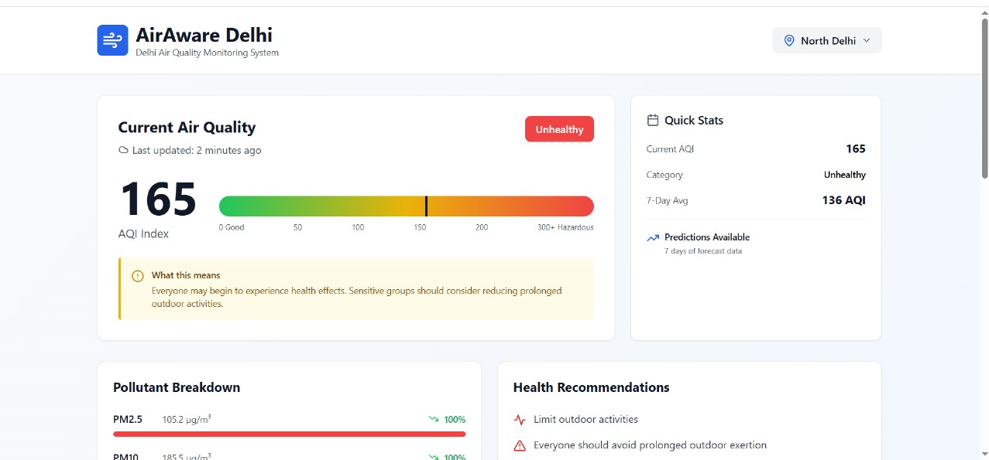
Output screens

Slide 7
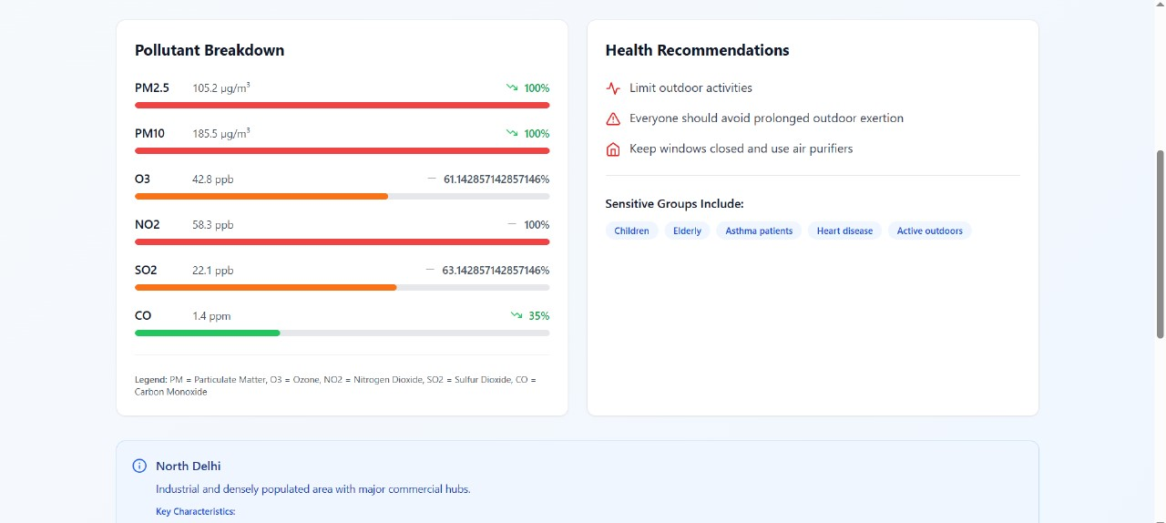

Slide 8
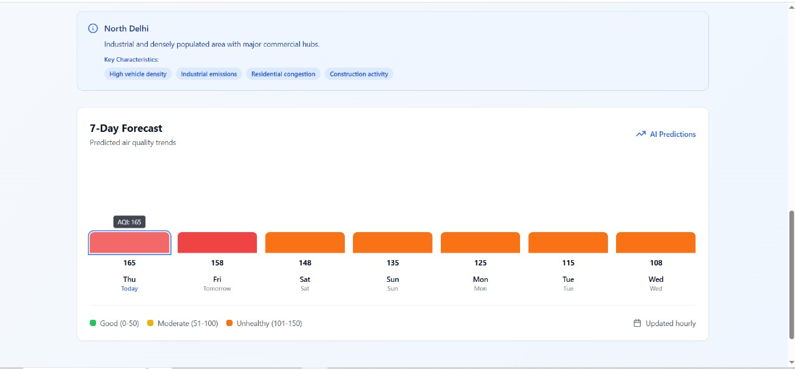

Slide 9
THANK YOU!

